Slide 1
Python Project: Language Translator
By Malla Sameer
B.Tech CSE Data Science and Machine Learning
Lovely Professional University

Slide 2

01
Interactive interface for translating text between languages.
02
Supports over 100 languages using Google Translate.
Overview of the Language Translator
03
Designed with a user-friendly GUI using Tkinter.
04
Tracks translation history for better usability.
05
Enables language swapping for convenience.

Slide 3
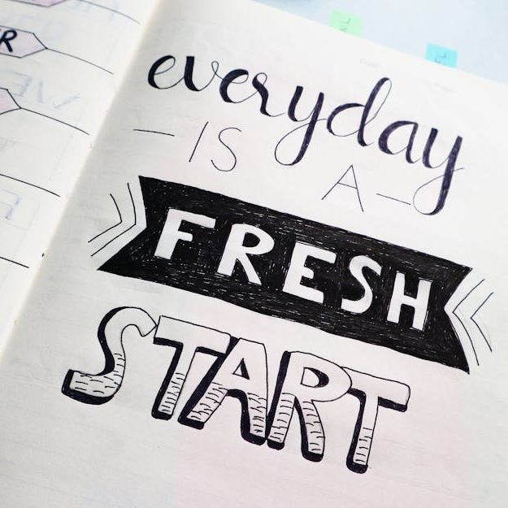
Features: Input & Output Fields
Input Text Area
The app provides a text field where users can enter text in the source language.
Output Text Area
Displays the translated text in the chosen target language.
Ease of Use
Fields are designed to be simple, intuitive, and responsive for a seamless experience.

Slide 4

What is the swapping feature?
Why is it essential?
The app allows users to swap source and target languages with a single click.
This saves time and effort, especially during bilingual communication.

Slide 5
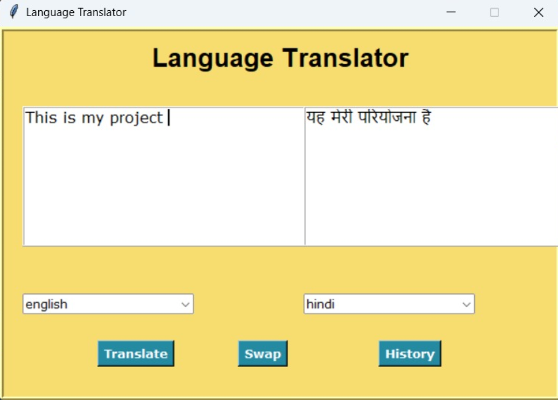
GUI Design: Components
Buttons
The interface includes buttons for translation, swapping languages, and viewing history.
Dropdown Menus
Language selection is done using dropdown menus for user convenience.
Text Fields
Two fields are provided for input and translated output, ensuring a simple layout.

Slide 6
Code Architecture
Core Methods
Event Handling
Error Handling
Functions like translate, swap_languages, and show_history form the app's backbone.
Tkinter binds user actions to corresponding code functions seamlessly.
The app gracefully handles invalid inputs and exceptions for smooth user experience.

Slide 7
Practical Scenarios
Where can it be used?
The translator app is useful for multilingual communication, educational purposes, and personal or professional translations.
Tourists can communicate with locals using translation interface for basic conversations.
Enables doctors and medical staff to interact with non-native speakers for accurate diagnosis and treatment.
Real-World Applications

Slide 8
Handling Complex Translations
Challenges & Solutions
CH: Many languages lack sufficient training data, which limits translation quality for these languages.
SOL: Promote crowdsourced data collection from native speakers to expand datasets for underrepresented languages.
CH: Sentences with multiple meanings or unclear grammer can result in mistranslations.
SOL: Implemented user feedback loops to clarify uncertain phrases.

Slide 9

Future Enhancements
Voice Input/Output
Integrating voice support will allow users to speak and listen to translations.
Offline Support
An offline mode will be beneficial for areas with poor connectivity.
Enhanced Design
Future versions can include advanced UI features for a more interactive experience.

Slide 10
Conclusion
In an increasingly interconnected world, language translators are effective tools for bridging communication gaps. These system offer smooth translation across different languages by utilizing developments in machine learning and natural language processing(NLP).
The Language Translator serves as an example of how technology may offer instantaneous, approachable ways to overcome language obstacles. Text translation, history tracking and language swapping are just a few of the characteristics that make these applications useful for
Personal communication, business, education and travel.

